Slide 1


Static Front-End Project
“Amruta Training Institute”
By: Guide
Amruta Chaware Jayant V

Slide 2
Content :
Introduction
Short about Front End technologies
Modules
Conclusion

Slide 3
Introduction:
This is about Static Front End Project
Name of the website is “Amruta Training Institute”
This training institute is related to IT field
We provide multiple technologies like Web Development, Software Development, Software Testing
Some courses are for Free of cost and some courses are paid

Slide 4
About Front End Technology
HTML
Hypertext Markup Language
Provide static skeleton
CSS
Cascading Style Sheets
Make out website beautiful and modern looking

Slide 5
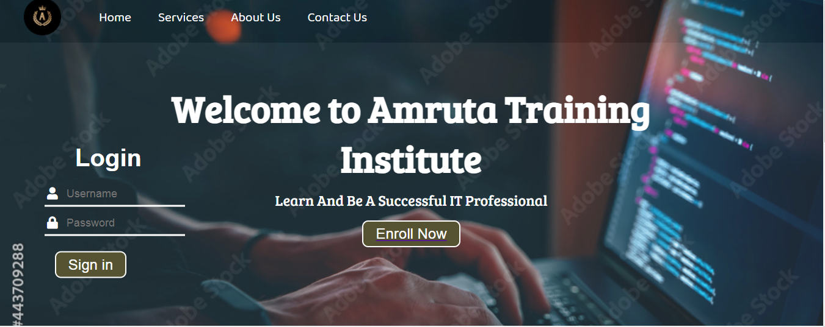
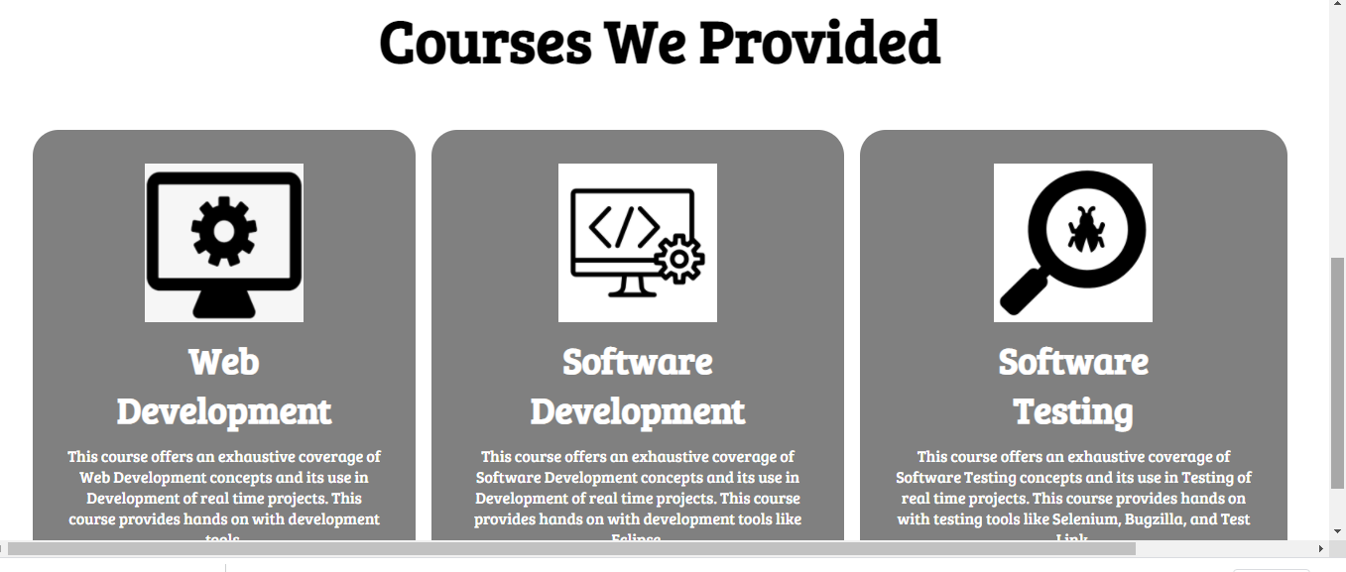
Modules Home Page :

Slide 6
Home Page includes
Header
Home
Services
About Us
Contact Us
Login
Registration
Courses
Web Development
Software Development
Software Testing

Slide 7
Conclusion
These websites help make the process of learning entertaining and attractive to the student, especially in today's age.
Thank You…

